Slide 1
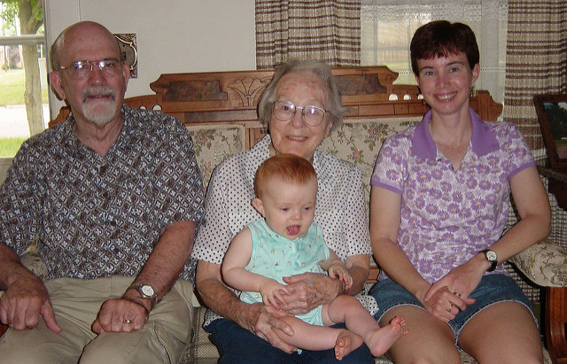
Charity Accumulation
Dr Ian Murray
Photo by Martin LaBar (25676024): www.flickr.com

Slide 2

Window of opportunity for action about charity ‘accumulation’, but…
What really is the problem?
What is the range of policy solutions?
Leading to…
‘Intergenerational justice’
Implementing intergenerational justice

Slide 3

Reframing the problem
Is there a problem?
Then, from…
[The question is] whether the broader policy settings for charities are encouraging appropriate levels of distribution… the Government [should] periodically review the charitable sector’s use of what would otherwise be tax revenue, to verify that the intended social outcomes are actually being achieved (TWG)
Holding accumulated funds without clear explanation may cause public concern that a charity is not using its funds for charitable purposes… concerns have been raised regarding charities with businesses that apply very little or no funds to charitable purposes. (CA Discussion Document)
[Private foundations may involve] minimal use of [foundation] funds for charitable purposes, with no particular distributions policy and no rationale for accumulation except a desire for the fund to be self-sustaining in the future, or for [foundation] distributions to occur years after donation tax relief has been obtained (TWG)

Slide 4
Reframing the problem
To…
How should charities allocate benefits over time – as between current and future generations – so as to enhance fairness and efficiency and thus the public benefit achieved?

Slide 5
Intergenerational Justice
‘Intergenerational justice’ refers to philosophical theories that seek to enunciate what obligations are owed by the present generation in relation to people in the past and the future.
Eg prioritarianism
Eg sufficientarianism
  Economic theory on social welfare maximisation can help to implement a selected position on intergenerational justice

Slide 6
Implementing intergenerational justice: the policy solutions
Intergenerational Justice via…
NZ tax and transfer system
Mandatory distribution rates
Let the regulator decide
Charity controller decision-making process

Slide 7
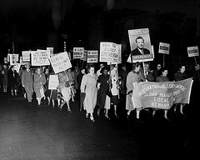
Questions / Feedback?
Photo 5780PB18F7D from the Kheel Center for Labor-Management Documentation and Archives at Cornell University
See flickr.com for licence terms
Dr Ian Murray
Deputy Head of School - Research, UWA Law School
ian.murray@uwa.edu.au
+8 6488 8520

